Slide 1

Multiple Features
Linear Regression with multiple variables
Machine Learning
Slides from CS-229 by Andrew Ng

Slide 2
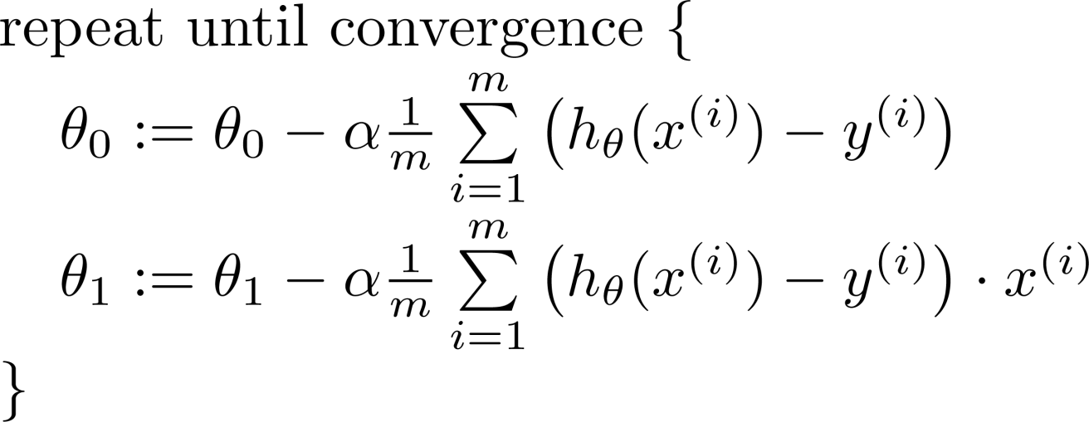




Recap:
Batch Gradient descent algorithm
$\frac{d}{dθ_{0}}∙J(θ_{0},θ_{1})$
update
and
simultaneously
$\frac{d}{dθ_{1}}∙J(θ_{0},θ_{1})$

Slide 3


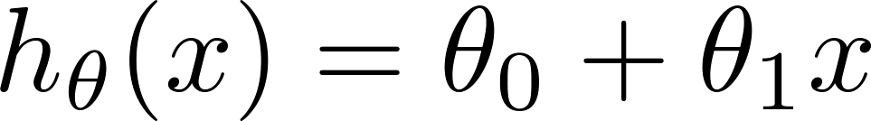
One feature (variable).
Size (feet²) | Price ($1000)
2104 | 460
1416 | 232
1534 | 315
852 | 178
… | …

Slide 4
Multiple features (variables).
Size (feet²) | Number of bedrooms | Number of floors | Age of home (years) | Price ($1000)
2104 | 5 | 1 | 45 | 460
1416 | 3 | 2 | 40 | 232
1534 | 3 | 2 | 30 | 315
852 | 2 | 1 | 36 | 178
… | … | … | … | …

Slide 5



Multiple features (variables).
Size (feet²) | Number of bedrooms | Number of floors | Age of home (years) | Price ($1000)
2104 | 5 | 1 | 45 | 460
1416 | 3 | 2 | 40 | 232
1534 | 3 | 2 | 30 | 315
852 | 2 | 1 | 36 | 178
… | … | … | … | …
Notation:
= number of features
= input (features) of training example.
= value of feature in training example.
Notes:
Pop-up Quiz

Slide 6
Hypothesis:
Previously:
Now:

Slide 7
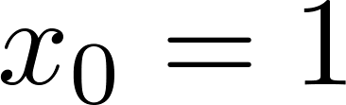
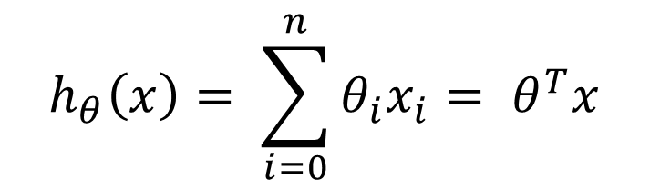
Hypothesis (multiple features):
For convenience of notation, define (intercept term)
Multivariate linear regression:
$$h_{θ}\left(x\right)= \sum_{i=0}^{n}{θ_{i}x_{i}= θ^{T}x}$$

Slide 8
Gradient descent for multiple variables
Linear Regression with multiple variables
Machine Learning

Slide 9
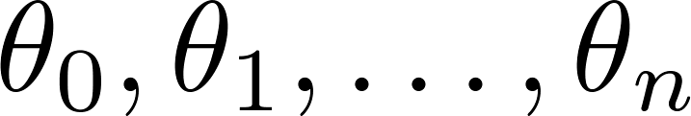
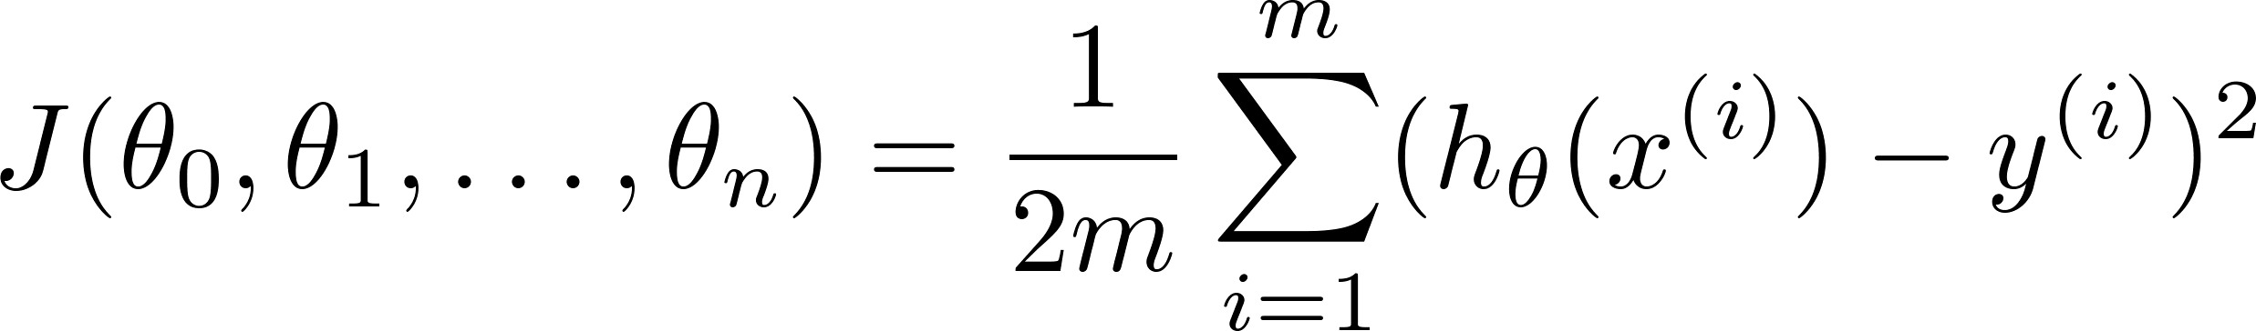

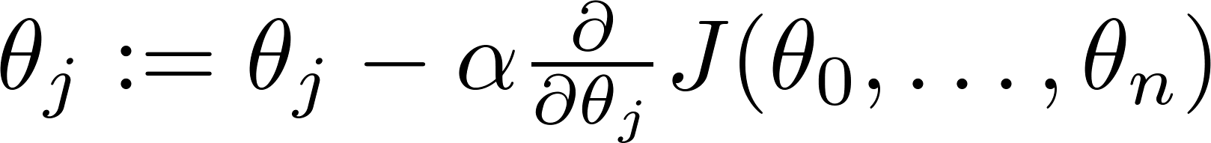

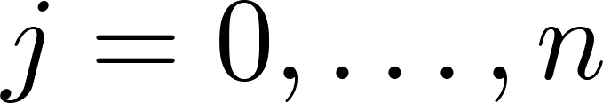
Hypothesis:
Parameters:
Cost function:
Gradient descent:
Repeat
(simultaneously update for every )

Slide 10

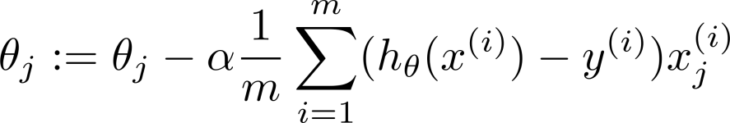
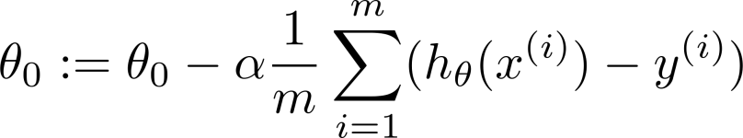



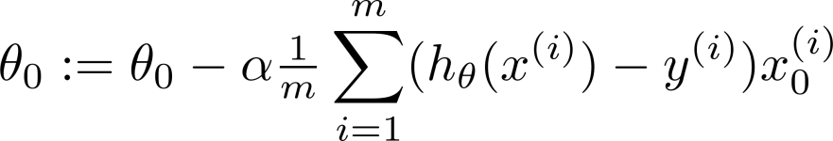
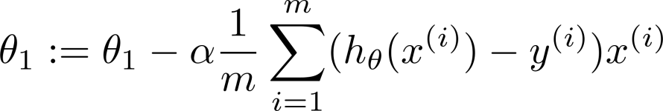
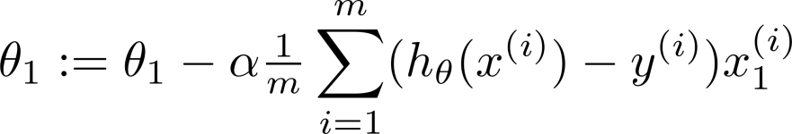

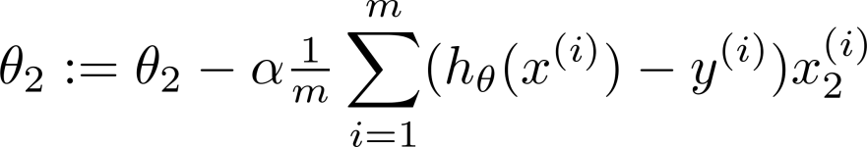
New algorithm :
Gradient Descent
Repeat
Previously (n=1):
Repeat
(simultaneously update for
)
(simultaneously update )

Slide 11
Assignment # 1
Multivariate Linear Regression

Slide 12
Gradient descent in practice: Feature Scaling
Linear Regression with multiple variables
Machine Learning

Slide 13
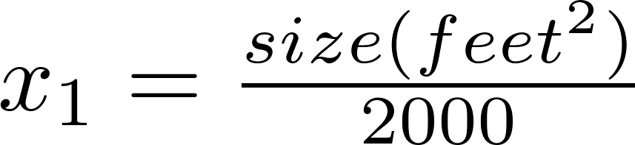


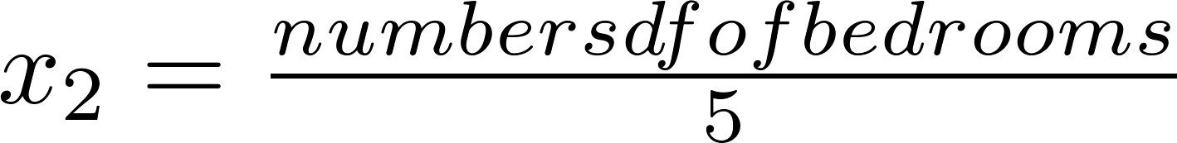
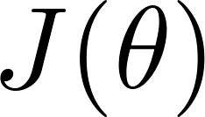


Feature Scaling
Idea: Make sure features are on a similar scale.
E.g. = size (0-2000 feet²)
= number of bedrooms (1-5)
size (feet²)
number of bedrooms

Slide 14
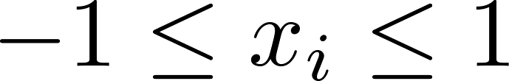
Feature Scaling
Get every feature into approximately a range.

Slide 15



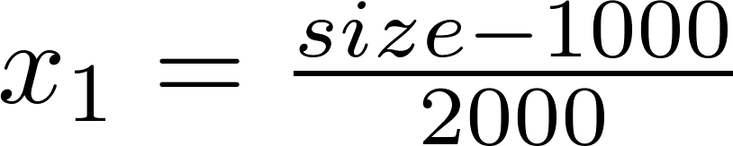
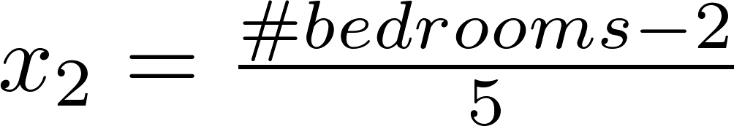
Mean normalization
Replace with to make features have approximately zero mean (Do not apply to ).
E.g.

Slide 16
Why, How and When to Scale your Features?
https://medium.com/greyatom/why-how-and-when-to-scale-your-features-4b30ab09db5e

Slide 17
Features and polynomial regression
Linear Regression with multiple variables
Machine Learning

Slide 18
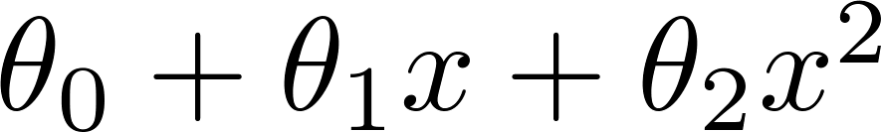
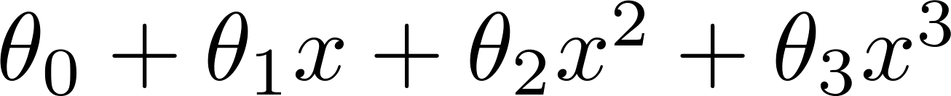
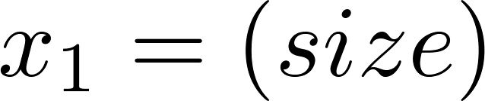
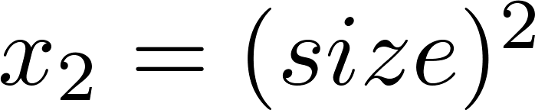
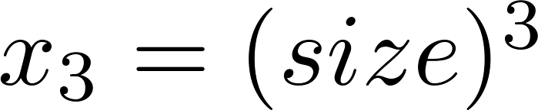
Polynomial regression
Price
(y)
Size (x)

Slide 19
Normal equation
Linear Regression with multiple variables
Machine Learning

Slide 20

Gradient Descent
Normal equation: Method to solve for
analytically.

Slide 21






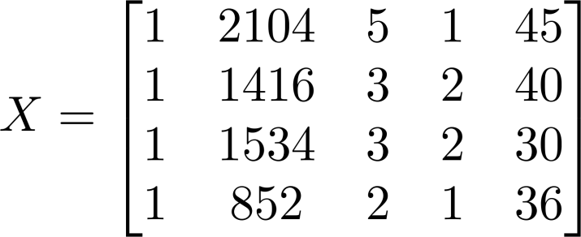
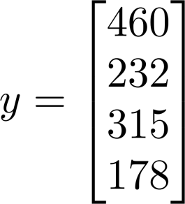
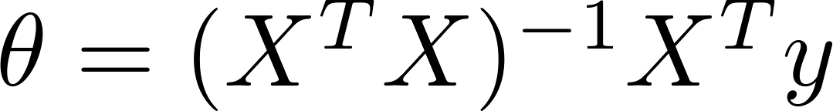
Examples:
 | Size (feet²) | Number of bedrooms | Number of floors | Age of home (years) | Price ($1000)
1 | 2104 | 5 | 1 | 45 | 460
1 | 1416 | 3 | 2 | 40 | 232
1 | 1534 | 3 | 2 | 30 | 315
1 | 852 | 2 | 1 | 36 | 178
Size (feet²) | Number of bedrooms | Number of floors | Age of home (years) | Price ($1000)
2104 | 5 | 1 | 45 | 460
1416 | 3 | 2 | 40 | 232
1534 | 3 | 2 | 30 | 315
852 | 2 | 1 | 36 | 178
Notes:
Pop-up Quiz

Slide 22
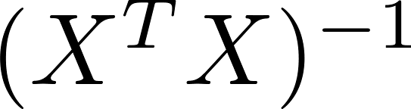
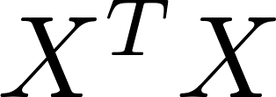
is inverse of matrix .

Slide 23

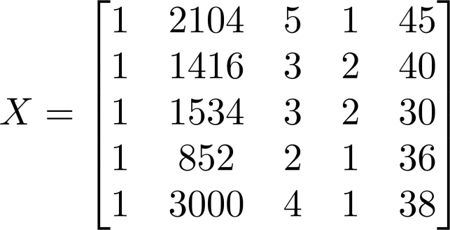
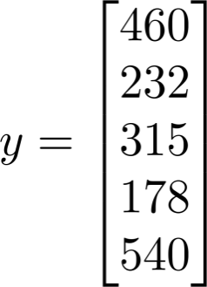
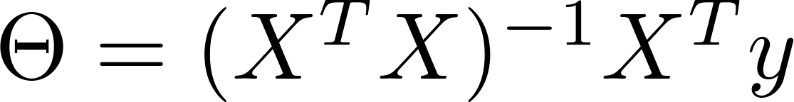
Examples:
 | Size (feet²) | Number of bedrooms | Number of floors | Age of home (years) | Price ($1000)
1 | 2104 | 5 | 1 | 45 | 460
1 | 1416 | 3 | 2 | 40 | 232
1 | 1534 | 3 | 2 | 30 | 315
1 | 852 | 2 | 1 | 36 | 178
1
Size (feet²) | Number of bedrooms | Number of floors | Age of home (years) | Price ($1000)
2104 | 5 | 1 | 45 | 460
1416 | 3 | 2 | 40 | 232
1534 | 3 | 2 | 30 | 315
852 | 2 | 1 | 36 | 178
3000 | 4 | 1 | 38 | 540
Notes:
Pop-up Quiz

Slide 24



training examples, features.
Gradient Descent
Normal Equation
Need to choose .
Needs many iterations.
No need to choose .
Don’t need to iterate.
Works well even when is large.
Need to compute
Slow if is very large.

Slide 25
Linear Regression with Least Mean Square
Gradient Descent Vs. Normal Equation
https://datascience.stackexchange.com/questions/14118/linear-regression-lms-with-gradient-descent-vs-normal-equations

